Slide 1
Pre Calculus 12 Section 2.2 Square Root of a Function
© Copyright all rights reserved to Homework depot: www.BCMath.ca

Slide 2
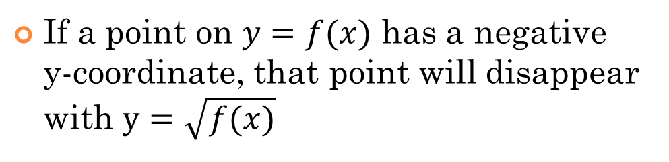
Square Root of a Function:
In this section, we will look at a new transformation:
With this transformation, the “x” coordinates DO NOT change, they stay the same!!
The “Y” coordinates will be square rooted
If a point on $y=f(x)$ has a negative y-coordinate, that point will disappear with $y=\sqrt{f(x)}$
Any point with a y-coordinate of “1” or “0” will be “invariant” [stays the same]

Slide 3
Square Root of a Linear Function:
The square root of a “linear function” will become a “root function”
LINEAR FUNCTION:
SQUARE ROOT OF A LINEAR FUNCTION:
Suppose we are given the graph of a linear function, and then asked to graph the “square root” of this linear function:
y
y
STEP 1: Any part of the graph with negative y-coordinate disappears!
4
4
STEP 2: The “x” intercept is where the root function begins
2
2
STEP 3: Draw the Invariant Point [$y=1$]
x
x
-2
-1
0
1
2
3
4
5
6
7
8
9
STEP 4: Find a point with a y-coordinate that is a Perfect Square. Square Root this point!
-2
-1
0
1
2
3
4
5
6
7
8
9
-2
-2
STEP 5: Connect the Dots and Draw the Root Function

Slide 4
Practice: Given each function $y=f(x)$, draw the graph of the following:
Since all 3 graphs are linear functions, the square root of each equation will be the top half of a sideways parabola
Start with “x” intercept, then y=1, then pick a point with a P.S. Y-coordinate
y
y
y
6
6
6
4
4
4
2
2
2
x
x
x
-2
0
2
4
6
8
-2
0
2
4
6
8
-2
0
2
4
6
8
-2
-2
-2
-4
-4
-4
-6
-6
-6

Slide 5
Square Root of a Quadratic Function:
The first step to drawing the graph of the Square Root of a Quadratic Function is to determine the shape of the parabola
Ie: Parabola opens UP or DOWN, shifted UP or DOWN
Next we need to find the X-intercepts of each parabola
This is a parabola that opens DOWN and shifted 16 units UP
This is a parabola that opens UP and shifted 25 units DOWN
This is a parabola that opens UP and shifted 9 units UP
Vertex of the parabola inside the root is (0,16)
Vertex of the parabola inside the root is (0,-25)
Vertex of the parabola inside the root is (0,9)
X-intercepts are (4,0) and (-4,0)
X-intercepts are (5,0) and (-5,0)
THERE are NO X-intercepts

Slide 6
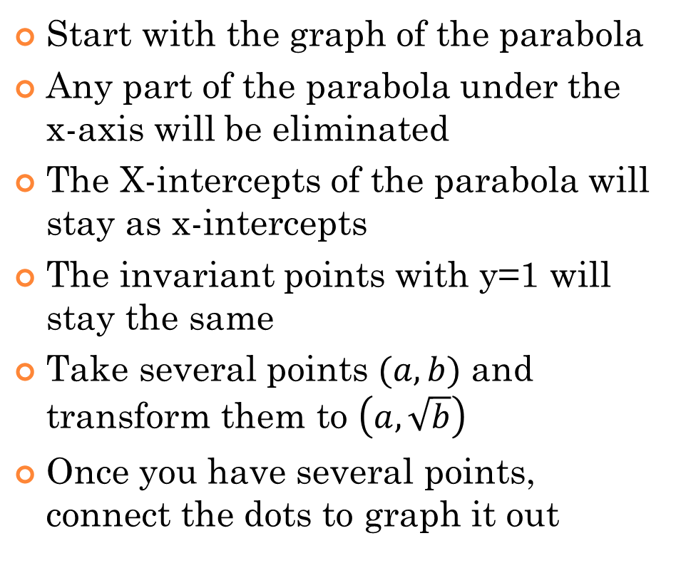
Square Root of a Quadratic Function:
First go through root of a parabola that opens UP and shifted down
Start with the graph of the parabola
Any part of the parabola under the x-axis will be eliminated
The X-intercepts of the parabola will stay as x-intercepts
The invariant points with y=1 will stay the same
Take several points $(a,b)$ and transform them to $\left(a,\sqrt{b}\right)$
Once you have several points, connect the dots to graph it out
y
6
4
2
x
-2
0
2
4
6
8
X-intercept (1,0) and (5,0)
-2
Invariant Points
-4
Connect the dots….
-6
We now have the TOP half of a HYPERBOLA!!

Slide 7
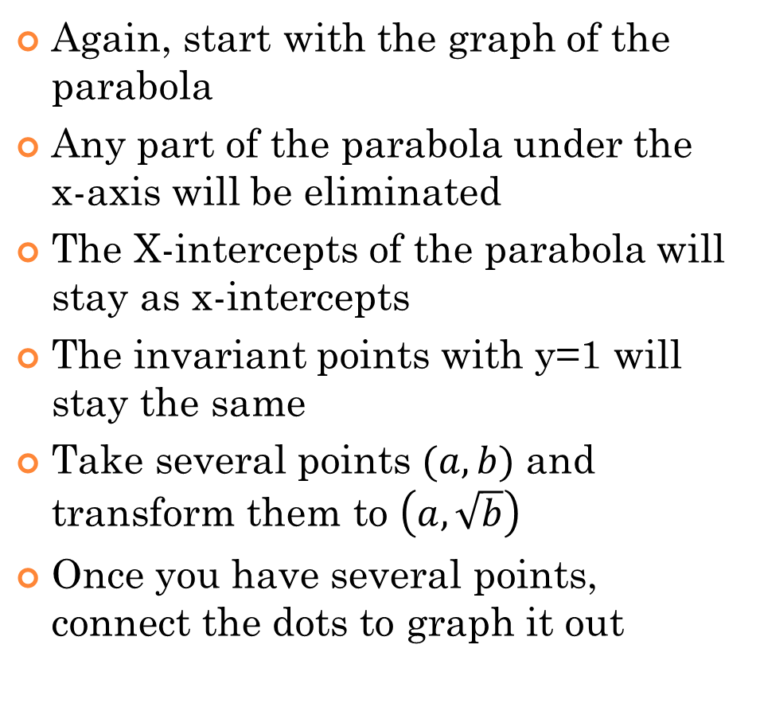
Square Root of a Quadratic Function:
Square Root of a Parabola that OPENS DOWN!
Again, start with the graph of the parabola
Any part of the parabola under the x-axis will be eliminated
The X-intercepts of the parabola will stay as x-intercepts
The invariant points with y=1 will stay the same
Take several points $(a,b)$ and transform them to $\left(a,\sqrt{b}\right)$
Once you have several points, connect the dots to graph it out
y
6
4
2
x
-2
0
2
4
6
8
-2
-4
X-intercept (0,0) and (4,0)
-6
Invariant Points
Connect the dots….
We now have a SEMI CIRCLE

Slide 8

Square Root of a Parabola that opens UP and Shifted UP
If a parabola opens UP and shifts UP, it will not have any X-intercepts
None of the parabola is below the X-axis, so nothing is eliminated….
y
6
So all we need to do is take some points, keep the “x” coordinates
Take the square root of the y-coordinates
4
2
x
-2
0
2
4
6
8
WE have the TOP half of a vertical HYPERBOLA!!
-2
-4
-6

Slide 9
Practice: Given each function $y=f(x)$, draw the graph of the following:
y
y
y
6
6
6
4
4
4
2
2
2
x
x
x
-2
0
2
4
6
8
-2
0
2
4
6
8
-2
0
2
4
6
8
-2
-2
-2
-4
-4
-4
-6
-6
-6

Slide 10
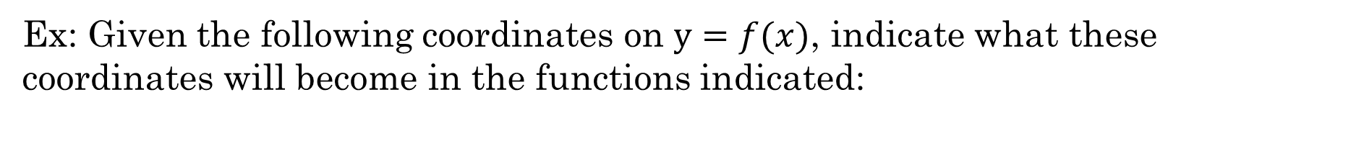
Ex: Given the following coordinates on $y=f(x)$, indicate what these coordinates will become in the functions indicated:

Slide 11
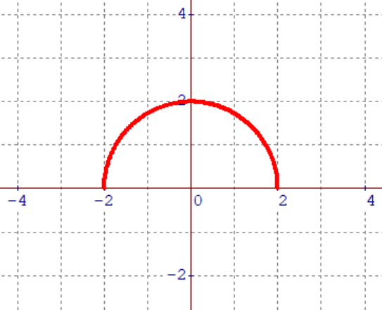
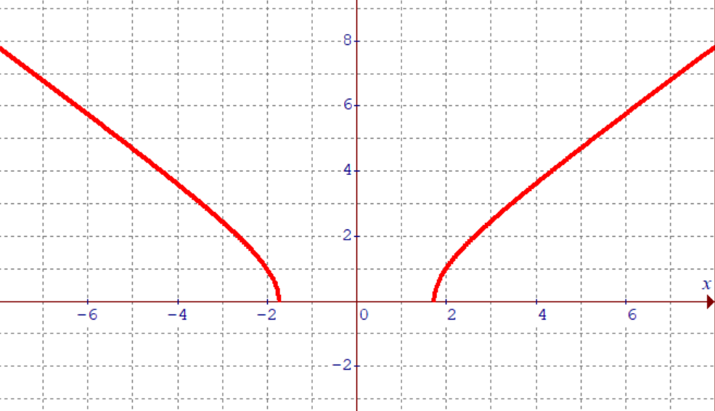
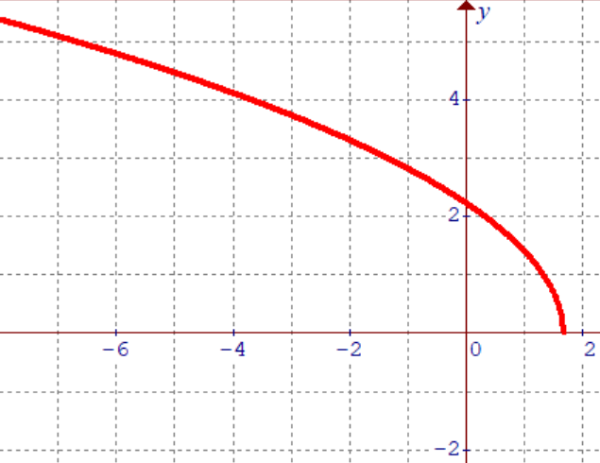
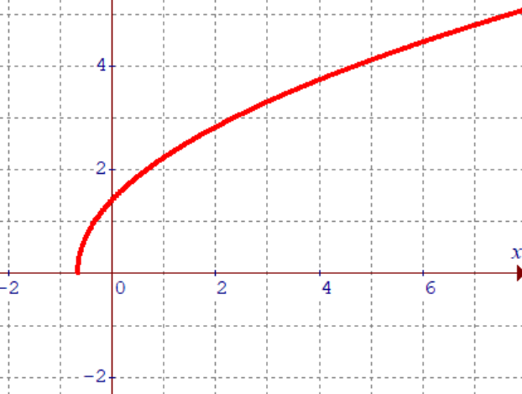
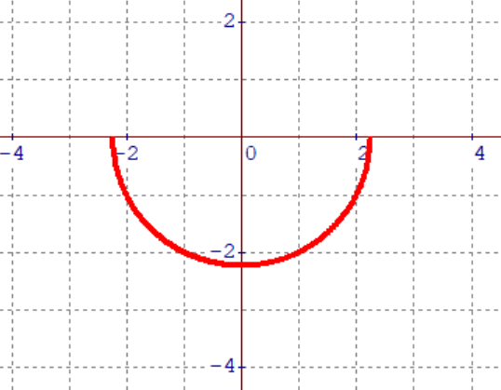
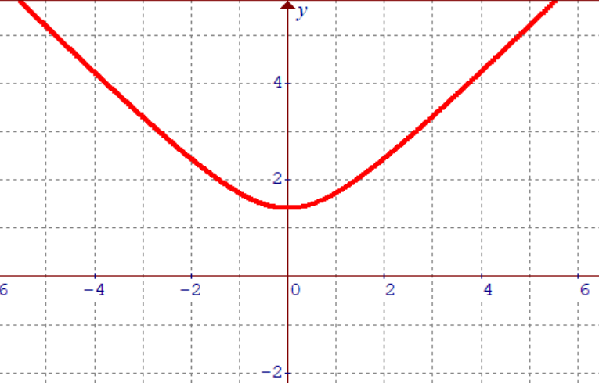
Practice: Match each equation with it’s graph:
A
B
C
D
E
F

Slide 12
Graph the function and then indicate the domain and range:
y
y
6
6
4
4
2
2
x
x
-2
0
2
4
6
8
-2
0
2
4
6
8
-2
-2
-4
-4
-6
-6

